Slide 1
Module 4.3
Unix and Windows Access Control Summary

Slide 2
Unix access control
 | File 1 | File 2 | …
User 1 | read | write | -
User 2 | write | write | -
User 3 | - | - | read
…
User m | Read | write | write
Process has user id
Inherit from creating process
Process can change id
Restricted set of options
Special “root” id
All access allowed
File has access control list (ACL)
Grants permission to user ids
Owner, group, other

Slide 3
Unix file access control list
Each file has owner and group
Permissions set by owner
Read, write, execute
Owner, group, other
Represented by vector of
four octal values
Only owner, root can change permissions
This privilege cannot be delegated or shared
Setid bits – Discuss in a few slides
setid
-
rwx
rwx
rwx
ownr
grp
othr

Slide 4
Question
Owner can have fewer privileges than other
What happens?
Owner gets access?
Owner does not?
Prioritized resolution of differences
if user = owner then owner permission
else if user in group then group permission
else other permission

Slide 5
Process effective user id (EUID)
Each process has three Ids (+ more under Linux)
Real user ID (RUID)
same as the user ID of parent (unless changed)
used to determine which user started the process
Effective user ID (EUID)
from set user ID bit on the file being executed, or sys call
determines the permissions for process
file access and port binding
Saved user ID (SUID)
So previous EUID can be restored
Real group ID, effective group ID, used similarly

Slide 6
Process Operations and IDs
Root
ID=0 for superuser root; can access any file
Fork and Exec
Inherit three IDs, except exec of file with setuid bit
Setuid system call
seteuid(newid) can set EUID to
Real ID or saved ID, regardless of current EUID
Any ID, if EUID=0
Details are actually more complicated
Several different calls: setuid, seteuid, setreuid

Slide 7
Setid bits on executable Unix file
Three setid bits
Setuid – set EUID of process to ID of file owner
Setgid – set EGID of process to GID of file
Sticky
Off: if user has write permission on directory, can rename or remove files, even if not owner
On: only file owner, directory owner, and root can rename or remove file in the directory

Slide 8
Example
Owner 18
RUID 25
SetUID
…;
…;
exec( );
program
Owner 18
…;
…;
i=getruid()
setuid(i);
…;
…;
-rw-r--r--
file
read/write
RUID 25
EUID 18
Owner 25
RUID 25
-rw-r--r--
read/write
EUID 25
file

Slide 9
Unix summary
Good things
Some protection from most users
Flexible enough to make things possible
Main limitation
Too tempting to use root privileges
No way to assume some root privileges without all root privileges

Slide 10
Weakness in isolation, privileges
Network-facing Daemons
Root processes with network ports open to all remote parties, e.g., sshd, ftpd, sendmail, …
Rootkits
System extension via dynamically loaded kernel modules
Environment Variables
System variables such as LIBPATH that are shared state across applications. An attacker can change LIBPATH to load an attacker-provided file as a dynamic library

Slide 11
Weakness in isolation, privileges
Shared Resources
Since any process can create files in /tmp directory, an untrusted process may create files that are used by arbitrary system processes
Time-of-Check-to-Time-of-Use (TOCTTOU)
Typically, a root process uses system call to determine if initiating user has permission to a particular file, e.g. /tmp/X.
After access is authorized and before the file open, user may change the file /tmp/X to a symbolic link to a target file /etc/shadow.

Slide 12
Access control in Windows
Some basic functionality similar to Unix
Specify access for groups and users
Read, modify, change owner, delete
Some additional concepts
Tokens
Security attributes
Generally
More flexible than Unix
Can define new permissions
Can give some but not all administrator privileges

Slide 13
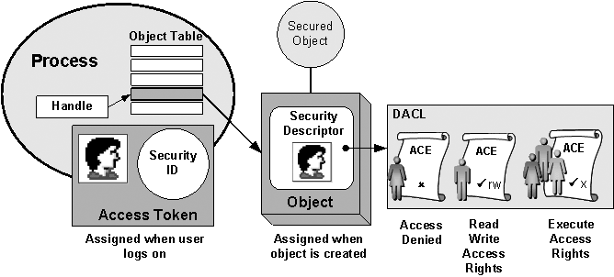

Slide 14
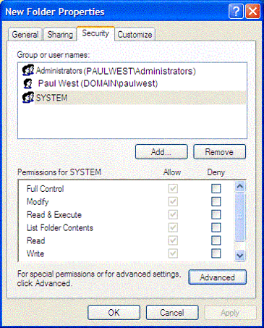
Identify subject using SID
Security ID (SID)
Identity (replaces UID)
SID revision number
48-bit authority value
variable number of Relative Identifiers (RIDs), for uniqueness
Users, groups, computers, domains, domain members all have SIDs

Slide 15
Process has set of tokens
Security context
Privileges, accounts, and groups associated with the process or thread
Presented as set of tokens
Impersonation token
Used temporarily to adopt a different security context, usually of another user
Security Reference Monitor
Uses tokens to identify the security context of a process or thread

Slide 16
Object has security descriptor
Security descriptor associated with an object
Specifies who can perform what actions on the object
Several fields
Header
Descriptor revision number
Control flags, attributes of the descriptor
E.g., memory layout of the descriptor
SID of the object's owner
SID of the primary group of the object
Two attached optional lists:
Discretionary Access Control List (DACL) – users, groups, …
System Access Control List (SACL) – system logs, ..

Slide 17
Example access request
Access token
User: Mark
Group1: Administrators
Access request: write
Action: denied
Group2: Writers
Revision Number
User Mark requests write permission
Descriptor denies permission to group
Reference Monitor denies request
(DACL for access, SACL for audit and logging)
Control flags
Owner SID
Group SID
DACL Pointer
Security descriptor
SACL Pointer
Deny
Priority:
Explicit Deny Explicit Allow Inherited Deny Inherited Allow
Writers
Read, Write
Allow
Mark
Read, Write

Slide 19
Impersonation Tokens (compare to setuid)
Process adopts security attributes of another
Client passes impersonation token to server
Client specifies impersonation level of server
Anonymous
Token has no information about the client
Identification
Obtain the SIDs of client and client's privileges, but server cannot impersonate the client
Impersonation
Impersonate the client
Delegation
Lets server impersonate client on local, remote systems

